Slide 1

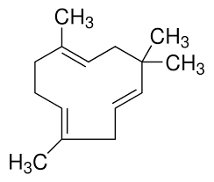
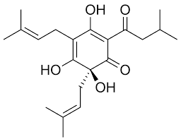
A Data Science-Driven Exploration of Beer Chemistry
Ayat Omar

Slide 2
Objective
Exploring and Identifying features within a dataset containing beer samples that are most significant in differentiating between different classes of beer.
Identifying features have several practical benefits for the brewing and beverage industry
Quality Control
Product Development
Cost Efficiency
Feature engineering tools can be employed to identify and analyze the most significant features within a dataset

Slide 3
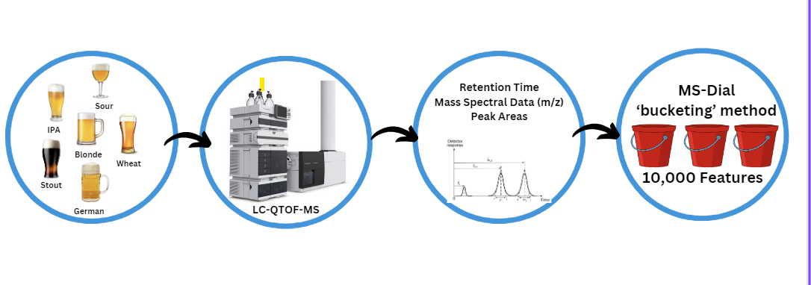
How Dataset Was Obtained

Slide 4
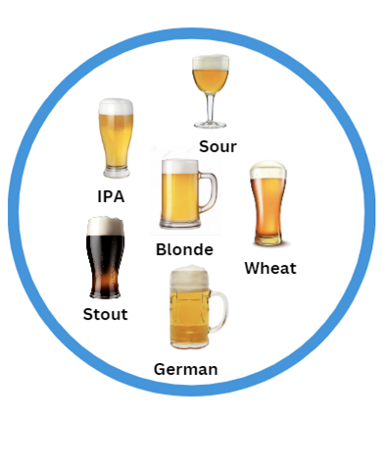
Beer Samples
Beer samples sent from Germany
Most common types of beers
Beer is composed of a wide variety of chemical compounds, including sugars, proteins, phenolic compounds, hops-derived substances, yeast metabolites, etc..

Slide 5
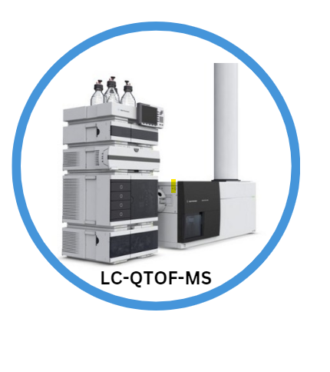
Liquid Chromatography Quadrupole Time-of-Flight Mass Spectrometer
Liquid Chromatography (LC): Liquid chromatography is used to separate the components of a sample (such as beer) into individual compounds
Quadrupole Mass Analyzer: allows only specific mass-to-charge ratio (m/z) ions to pass through, filtering out unwanted ions.
Time-of-Flight Mass Analyzer (TOF-MS): ions are accelerated and travel through a flight tube. The time it takes for ions to reach the detector provides information about their mass-to-charge ratio. This data is crucial for identifying the molecules present in the sample.

Slide 6
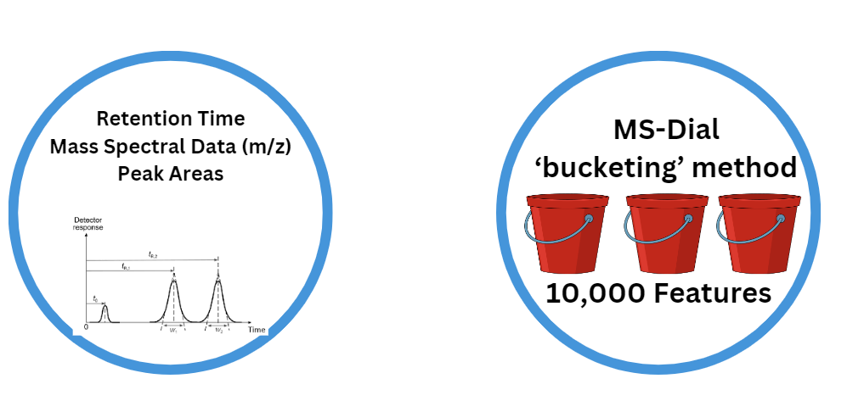
Data Acquisition
Retention Time: time it takes for a compound to travel through the chromatographic column and elute from the column.
Ion Mass Spectral Data (m/z): mass of an ionized molecule divided by its charge.
Peak Areas: intensity of the signals detected at specific retention times and m/z values.
Notes:
Retention Time: time it takes for a compound to travel through the chromatographic column and elute from the column.
Ion Mass Spectral Data (m/z): mass of an ionized molecule divided by its charge. Mass spectrometry measures the mass-to-charge ratio of ions to identify and quantify compounds.
Peak Areas: intensity of the signals detected at specific retention times and m/z values. These areas correspond to the abundance or concentration of specific compounds in the samples.

Slide 7
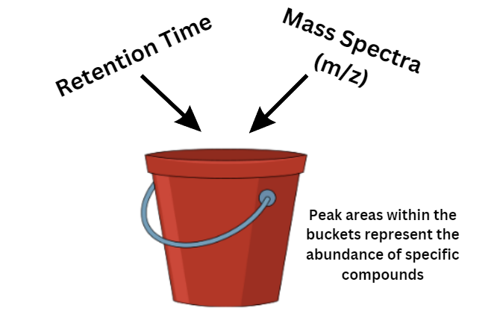
Data Processing
The bucketing method, also known as binning or discretization, is a technique used in data analysis to group continuous data into discrete intervals or "buckets.
Each ‘bucket’ represents a feature
Peak areas within the buckets represent the prevalence or abundance of specific ions or compounds within those intervals
10,000 such features, each representing a specific combination of retention time and m/z range, along with the corresponding peak area

Slide 8
Beer Dataset
10,815 columns x 122 rows
Feature columns contain integer values
72 beer samples from 7 categories of beer (blonde, german, IPA, Stout, Wheat, Sour)
The dataset also included quality control and water samples

Slide 9
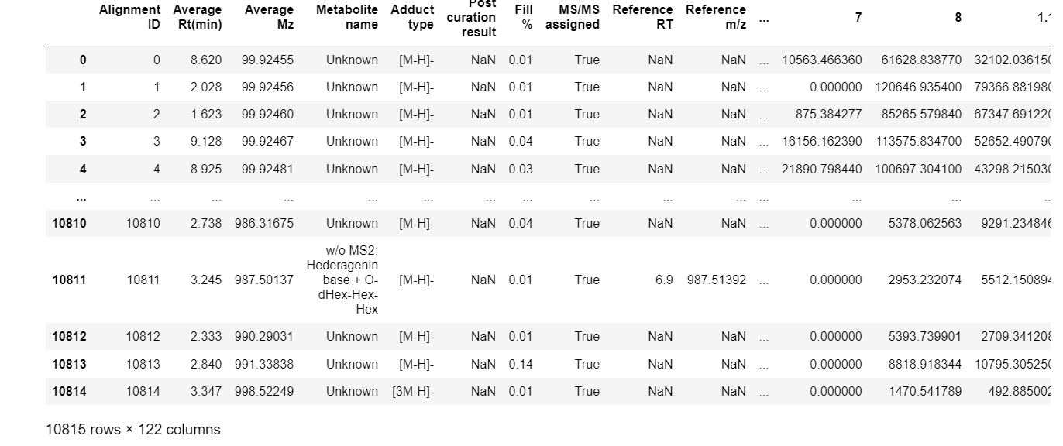
For cleaning the dataset, there is a lot of unnecessary information in the dataset, 50 columns were removed, only focusing on the features

Slide 10
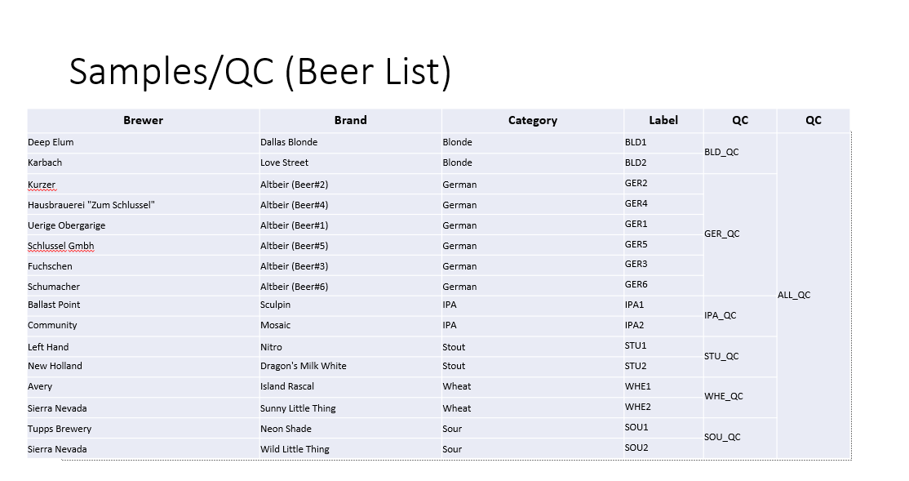

Slide 11
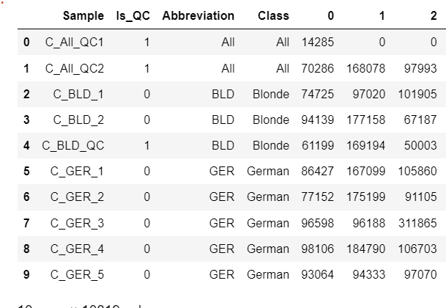
Data Cleaning and Formatting
New columns were created for the ‘Abbreviation; which extracted the three letters from the sample column
Mapping was defined between abbreviations and classes
A new column for quality control was proposed where samples were marked as 1 if QC and 0 if not.

Slide 12
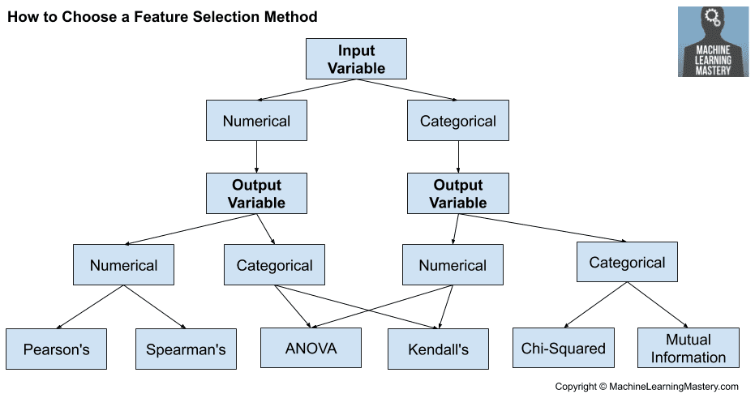

Slide 13
ANOVA
Objective: Identify features that significantly differentiate between beer classes.
Using the ‘f_classif’ score function from ‘sklearn.feature_selection’ for ANOVA
Producing top 10 features based on F-statistic values
Calculating P-values
Null Hypothesis (H0): here is no significant difference in the mean value of the feature across different classes.
Alternative Hypothesis (H1): There is a significant difference in the mean value of the feature across different classes.

Slide 14
Challenges Encountered and Solutions
Performing ANOVA without dimensionality reduction
‘Curse of dimensionality’: volume of the feature space increases exponentially, making it difficult to analyze and interpret the data effectively
risk of overfitting is higher when the number of features is large compared to the number of samples
PCA transforms the original high-dimensional feature space into a lower-dimensional space while retaining most of the variance in the data
The principal components derived from PCA often represent underlying patterns in the data

Slide 15
More Challenges….
Understanding the chemistry domain and what the features represent
Defining abbreviation and classes for beer samples
High dimensionality and limited sample size

Slide 16
Plan for Next Semester
Feature Reduction: Use PCA to reduce the dimensionality of the dataset.
Correlation Analysis: Identify and possibly remove highly correlated features.
Ensemble Methods: Explore algorithms like Random Forest or Gradient Boosting for feature importance and classification.

